Slide 1

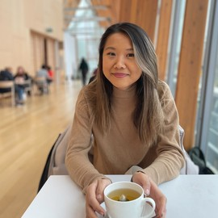
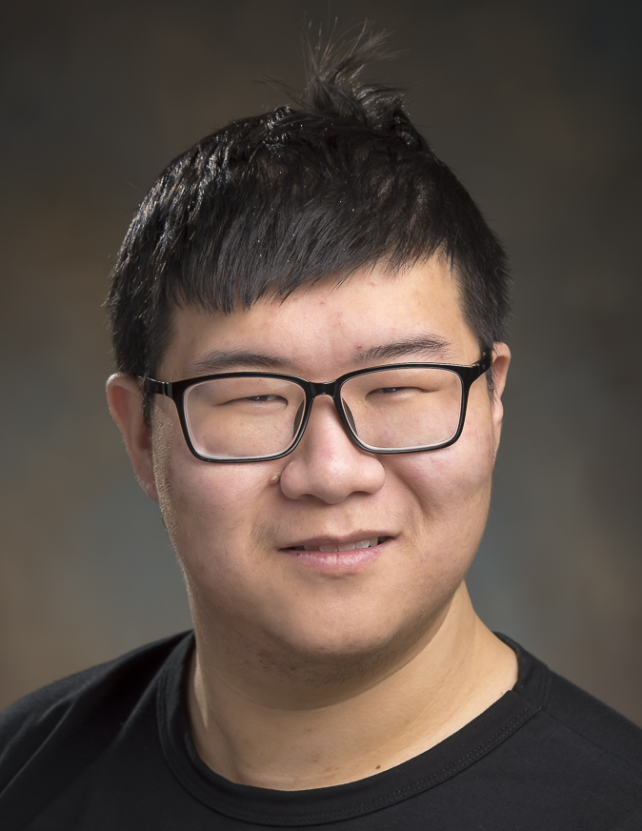
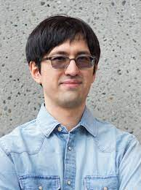

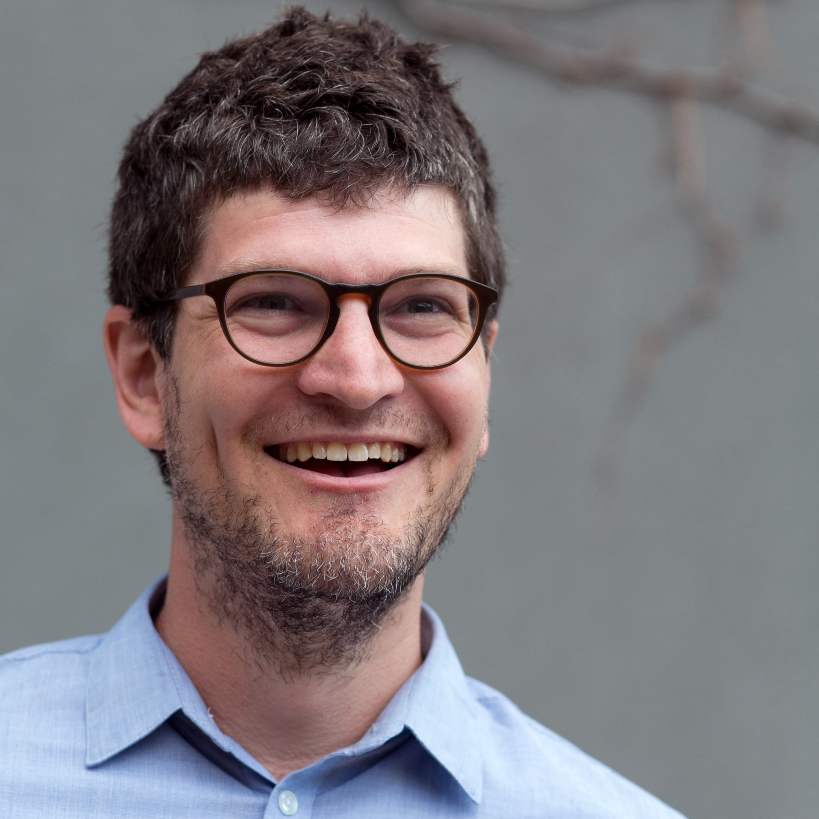


Text-guided Controllable Mesh Refinement for Interactive 3D Modeling
Yun-Chun Chen^{1,2}
Selena Ling^{1,2}
Zhiqin Chen²
Vladimir G. Kim²
Matheus Gadelha²
Alec Jacobson^{1,2}
1
2

Slide 2
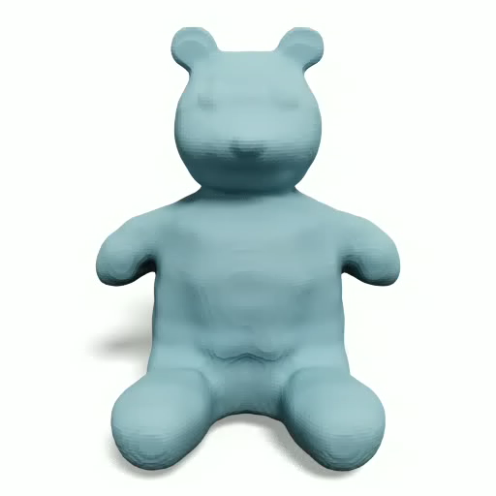
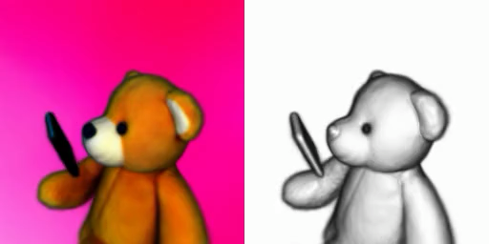
Text-to-3D Generative Modeling
[Poole et al. 2023]
[Jun et al. 2023]
Poole et al. DreamFusion: Text-to-3D Using 2D Diffusion. In ICLR, 2023.
Jun et al. Shap-E: Generating Conditional 3D Implicit Functions. arXiv, 2023.

Slide 3

User Control?
Raising hand up?
>_: A teddy bear
Input text prompt
Output 3D mesh

Slide 4
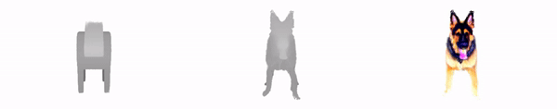
Methods based on Score Distillation Sampling
>_: A German Shepherd
Input guiding geometry
Output
Metzer et al. Latent-NeRF for Shape-Guided Generation of 3D Shapes and Textures. In CVPR, 2023.

Slide 5


Our Work: Text-guided Mesh Refinement
Input: A coarse 3D mesh and a text prompt
Goal: Create a 3D mesh by adding more geometric detail to the input coarse mesh guided by the input text prompt
>_: A teddy bear
Input 3D mesh
Input text
Output 3D mesh

Slide 6

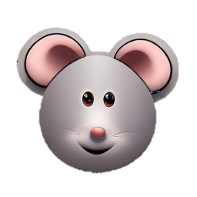
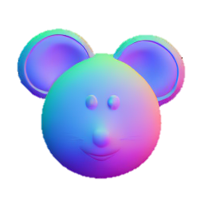

Main Idea
Refinement
Input 3D mesh
Depth rendering
RGB image
Normal image
Rendering
Diffusion
Prediction

Slide 7
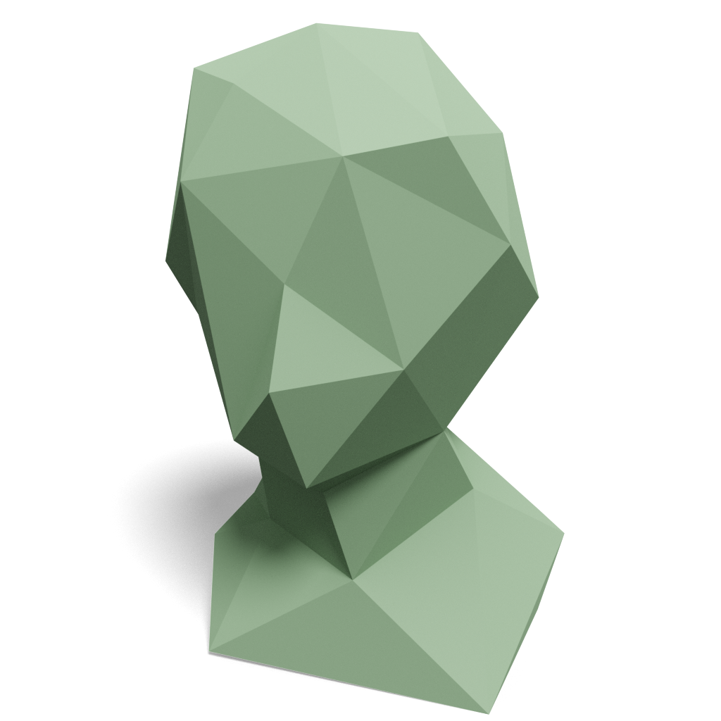
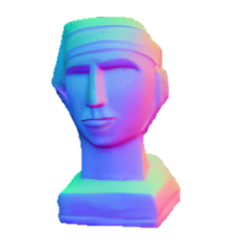
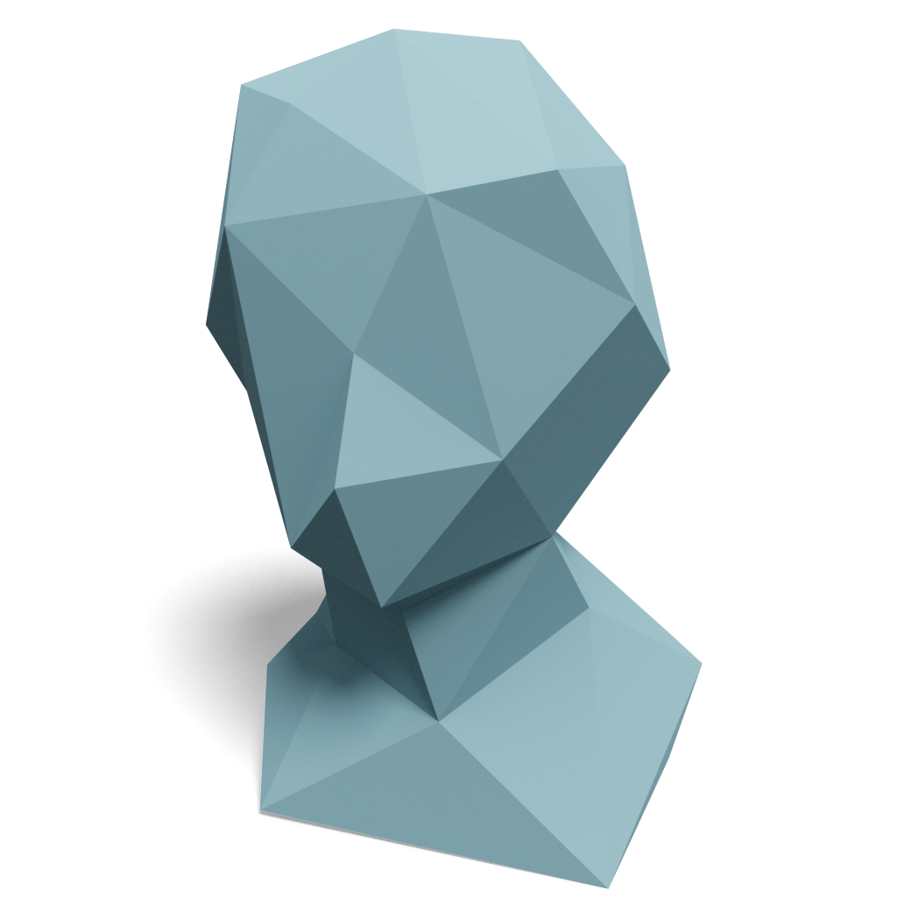
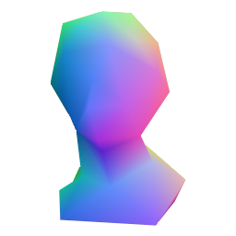
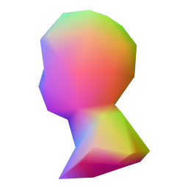
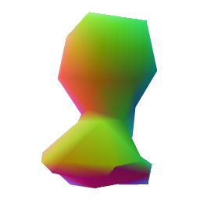
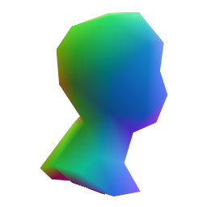
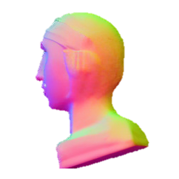
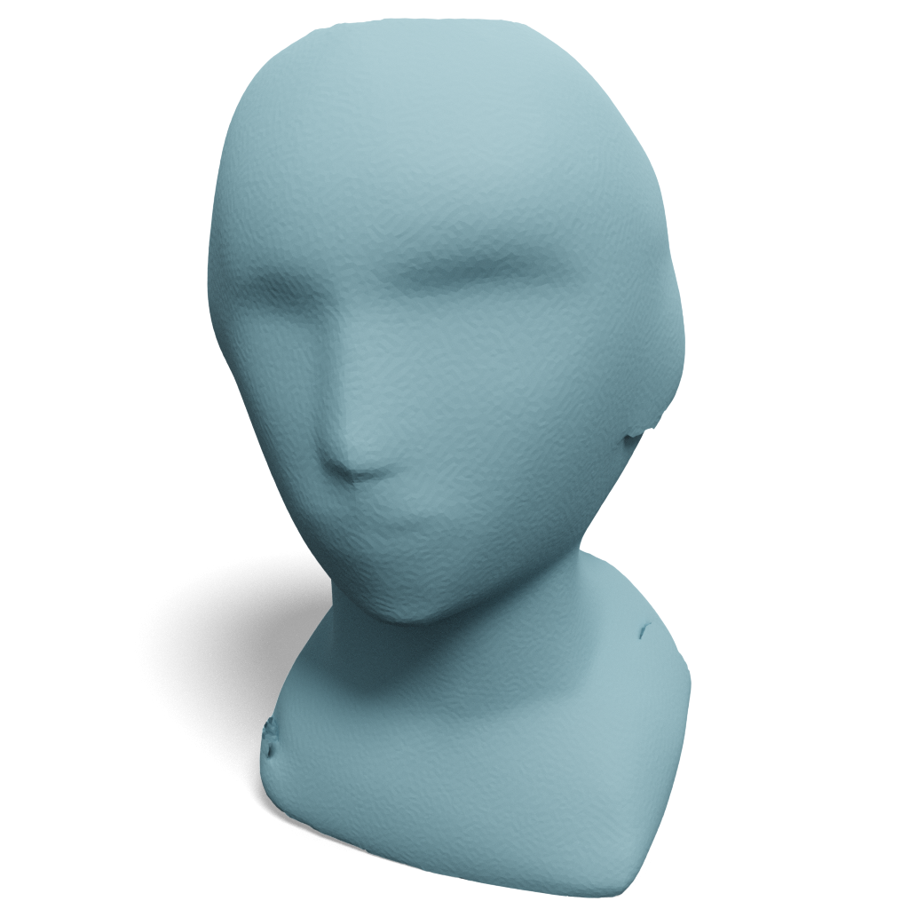
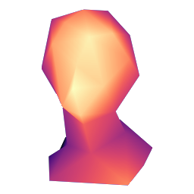
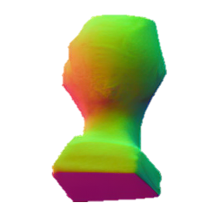
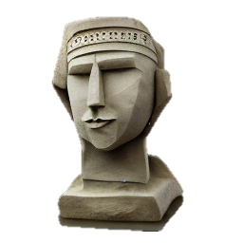
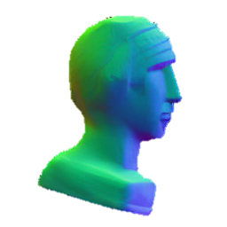
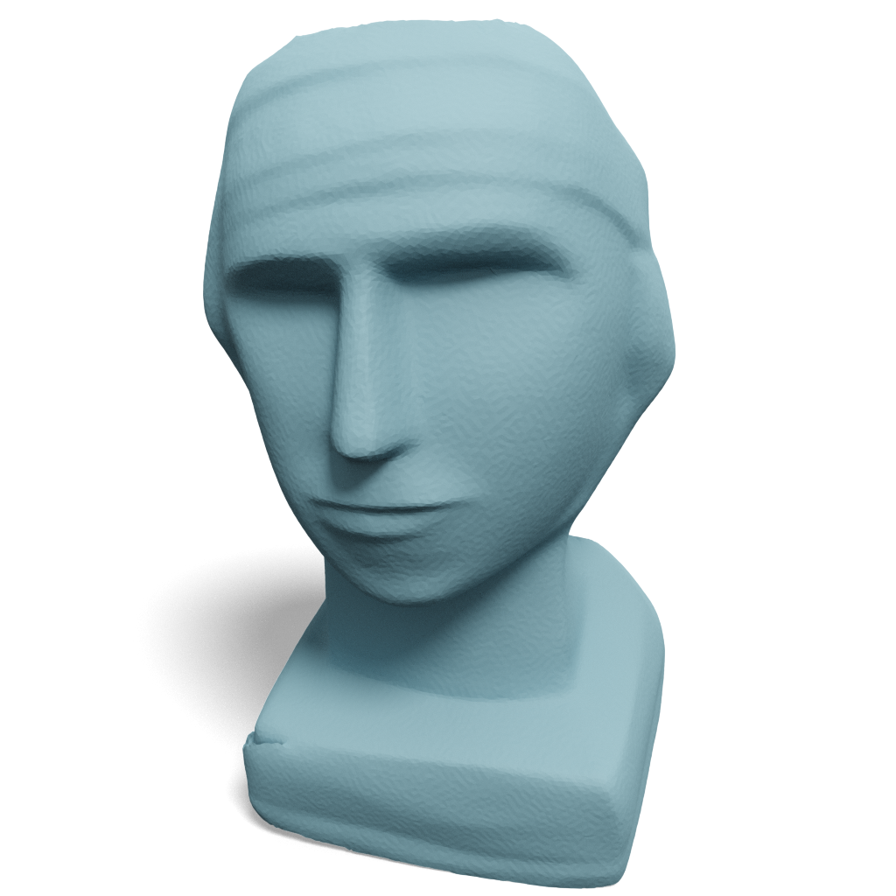
Method
…
Input 3D mesh
Multi-view normal renderings
…
Multi-view ControlNet
Depth rendering
>_: A stone figure
Input text prompt
Single-view ControlNet
RGB image
Multi-view
normal predictions
Mesh
optimization

Slide 8
Single-view ControlNet
Input 3D mesh
Depth rendering
>_: A stone figure
Input text prompt
Single-view ControlNet
RGB image

Slide 9
Multi-view ControlNet
Input 3D mesh
Multi-view normal renderings
Multi-view ControlNet
Depth rendering
>_: A stone figure
Input text prompt
Single-view ControlNet
RGB image
Multi-view
normal predictions

Slide 10
Mesh Refinement
…
Input 3D mesh
Multi-view normal renderings
…
Multi-view ControlNet
Depth rendering
>_: A stone figure
Input text prompt
Single-view ControlNet
RGB image
Multi-view
normal predictions
Mesh
optimization

Slide 11
Mesh Optimization
R
Loss
Diff renderer
Input 3D mesh
Normal rendering
Target normal

Slide 12
Comparison to State-of-the-art Methods
>_: A Venus statue
CLIP sim / Runtime (s)
0.2367 / 3697
0.2327 / 5597
0.2556 / 2971
0.2666 / 32
Input 3D mesh
Latent-NeRF
Magic3D
Fantasia3D
Ours

Slide 13
Comparison to State-of-the-art Methods
Ours vs. Latent-NeRF
Ours vs. Magic3D
Ours vs. Fantasia3D
Visual quality
Visual quality
Visual quality
Geometric detail
Geometric detail
Geometric detail
Mesh text consistency
Mesh text consistency
Mesh text consistency

Slide 14





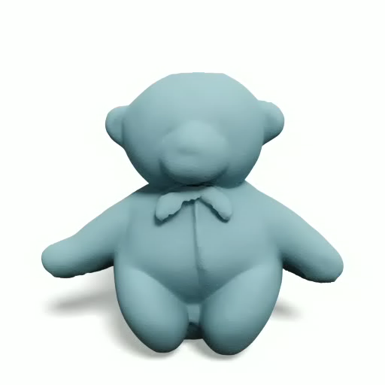
>_: A cartoon figure
>_: A teddy bear
>_: A teddy bear
Input 3D mesh
Input 3D mesh
Input 3D mesh
Output 3D mesh
Output 3D mesh
Output 3D mesh

Slide 15

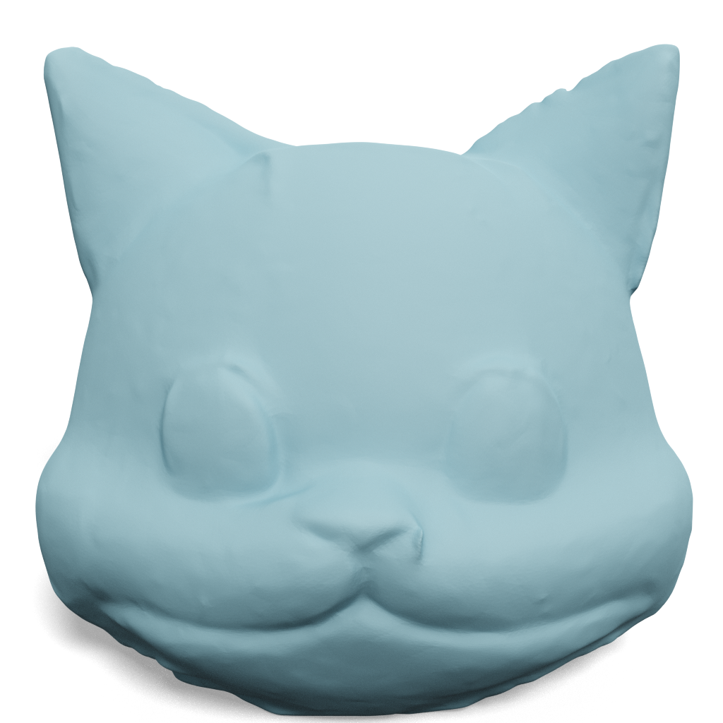
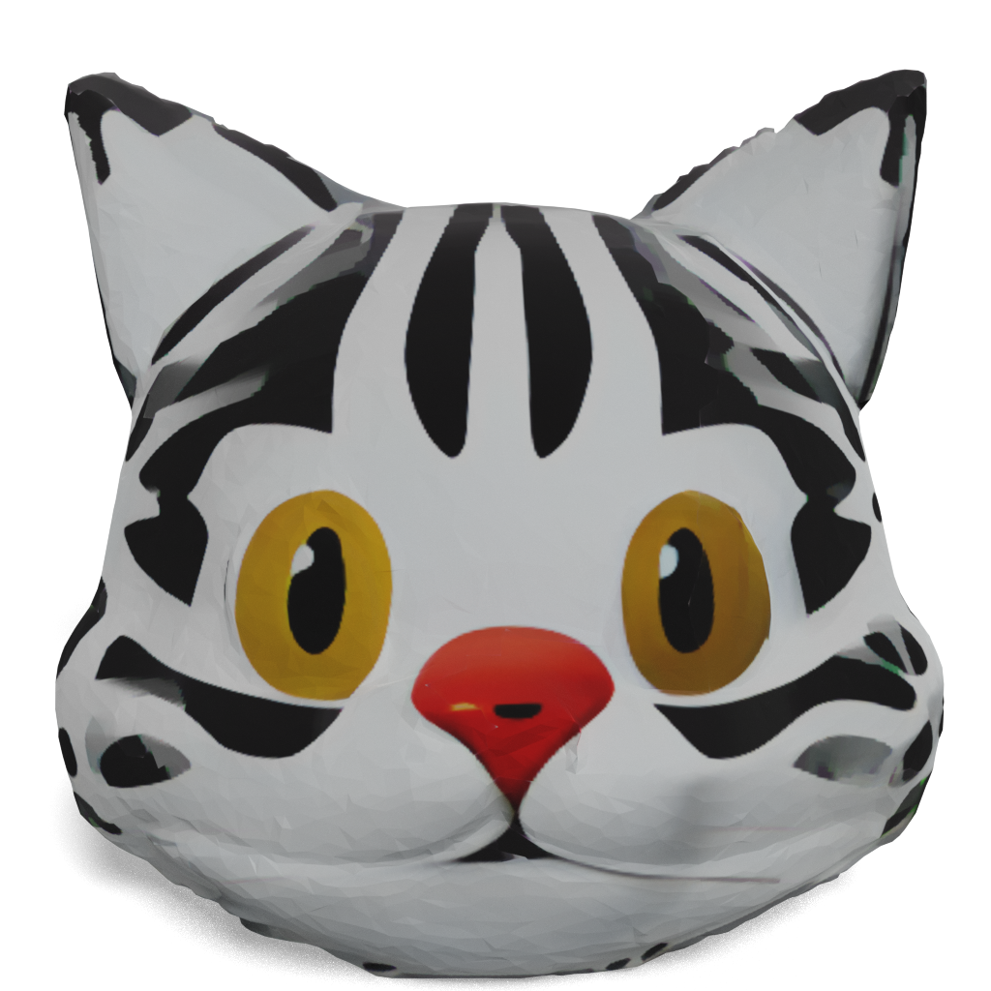
Mesh Texturing
>_: A cartoon cat head
Input 3D mesh
Ours
Ours with texture

Slide 16

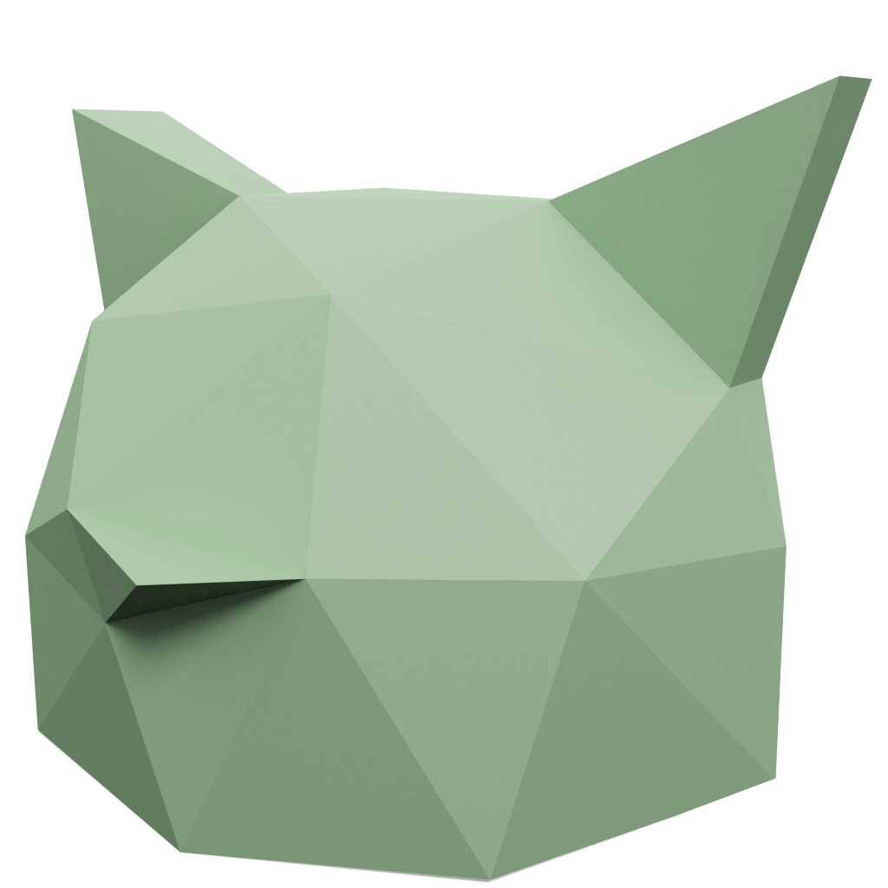
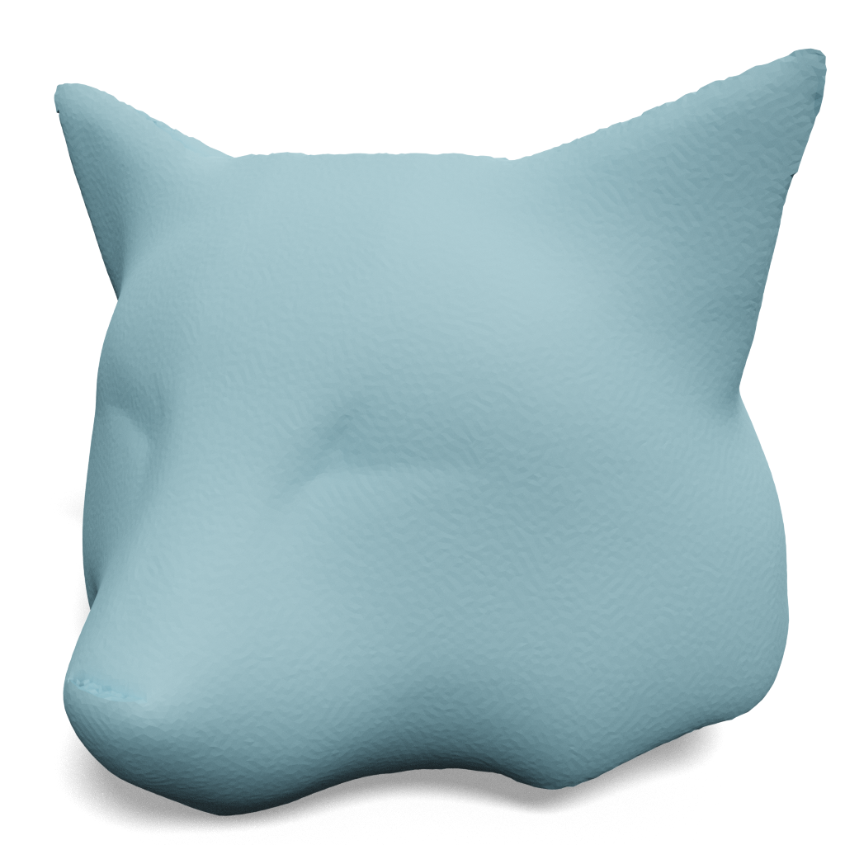

Conclusions
- Text-guided mesh refinement
- Explicit pose control
- Better quality & faster speed
>_: A teddy bear
>_: A teddy bear
>_: A coyote
Input 3D mesh
Input 3D mesh
Input 3D mesh
Output 3D mesh
Output 3D mesh
Output 3D mesh

Slide 17
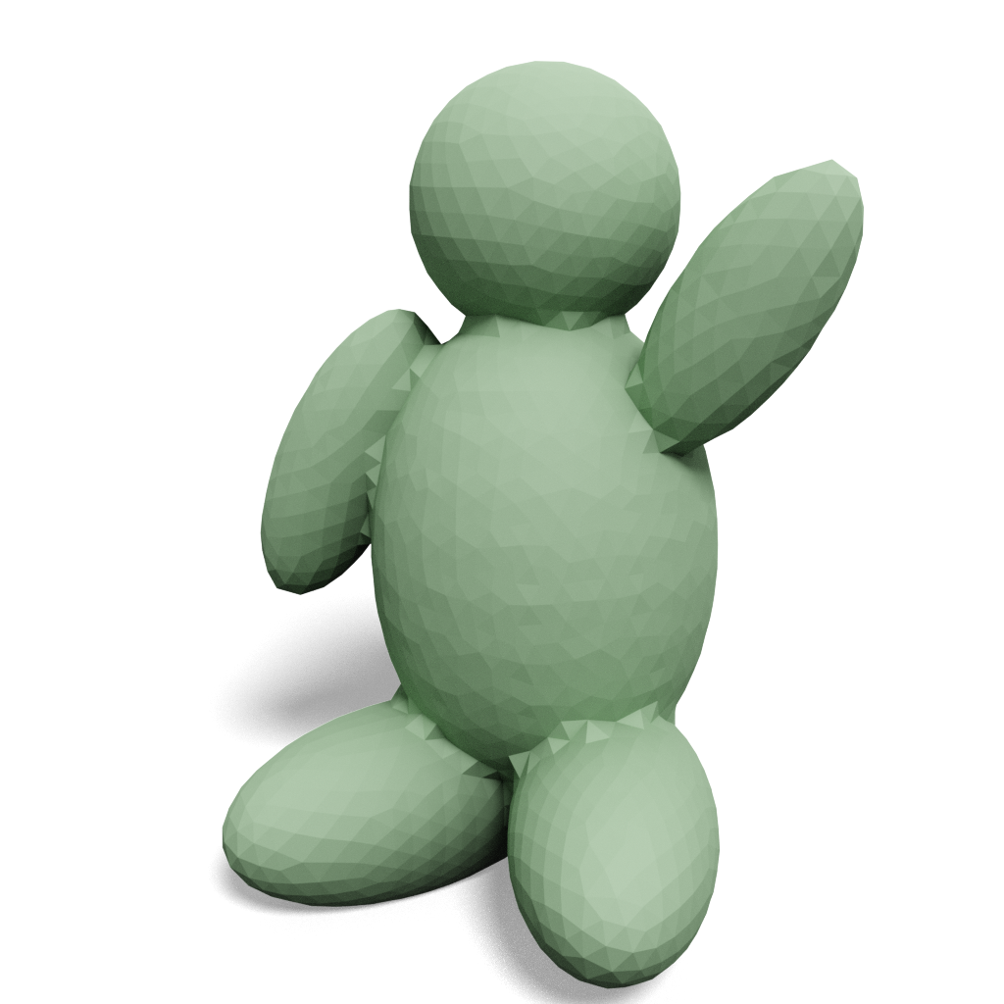
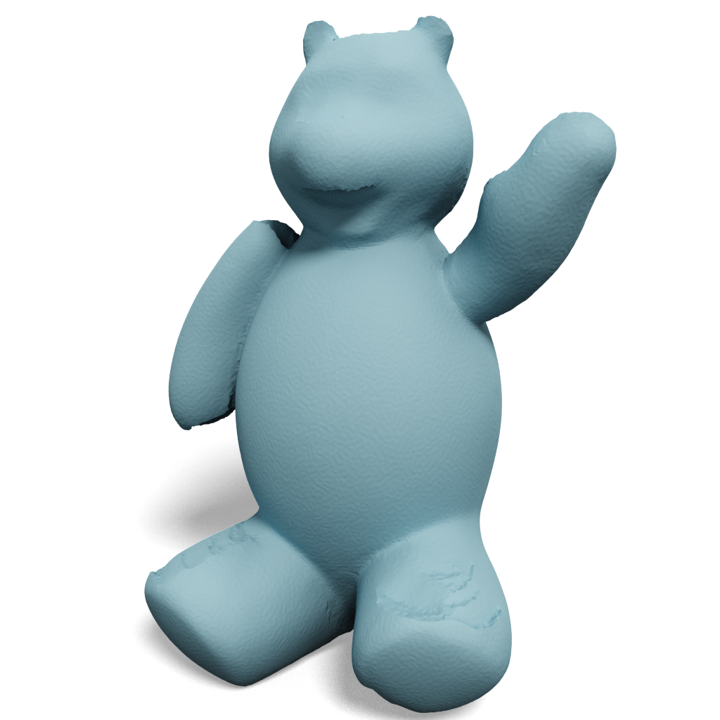


Future Work
- Identity preservation
- Localized detail refinement
>_: A teddy bear
>_: A teddy bear
Input 3D mesh
Input 3D mesh
Refine full shape
Zoom in & refine
Output 3D mesh
Output 3D mesh

